Slide 1
CSEE5590/490 Big Data Programming
Lesson 3 – Hadoop and Map Reduce

Slide 2
Reference Links
Additional Help on Hadoop Installation : https://www.digitalocean.com/community/tutorials/how-to-install-hadoop-in-stand-alone-mode-on-ubuntu-16-04
GitHub Installation In Ubuntu/Windows/Mac:
https://gist.github.com/derhuerst/1b15ff4652a867391f03

Slide 3
Additional Resources
Cloudera
https://archive.cloudera.com/cdh5/cdh/5/hadoop/hadoop-project-dist/hadoop-hdfs/HDFSCommands.html
Hadoop Commands Cheat sheet:
https://hadoop.apache.org/docs/r1.2.1/commands_manual.pdf
https://linoxide.com/images/hadoop-hdfs-commands-cheatsheet-900x1500.png
https://www.thegeekstuff.com/2015/02/hadoop-command-reference/#comments

Slide 4
INTELLIJ

Slide 5
IntelliJ
Java- Scala integrated development environment (IDE)
Can be Downloaded from https://www.jetbrains.com/idea/
IDE used for Hadoop/Spark

Slide 6
Attention
Make sure to add Scala to IntelliJ environment while installing

Slide 7
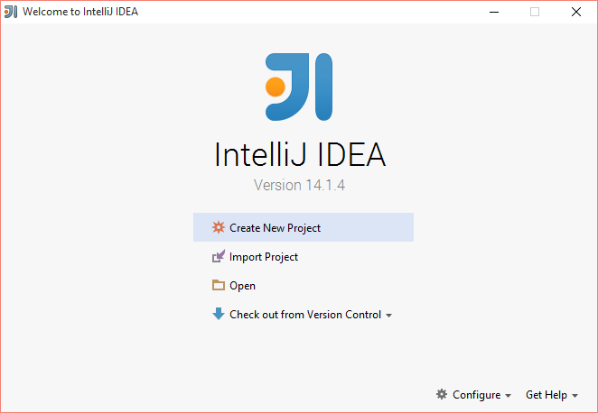

Slide 8
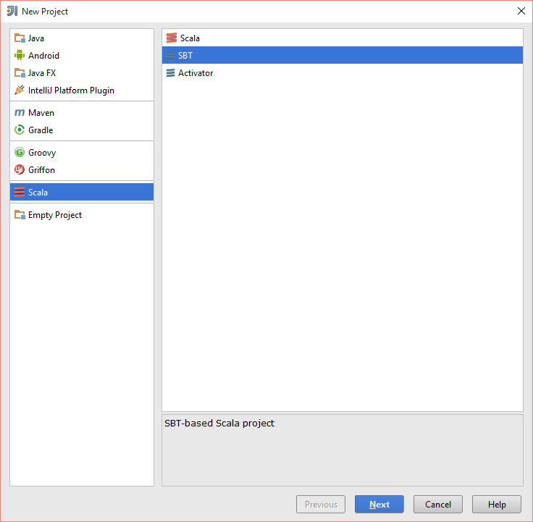
For Scala Project

Slide 9
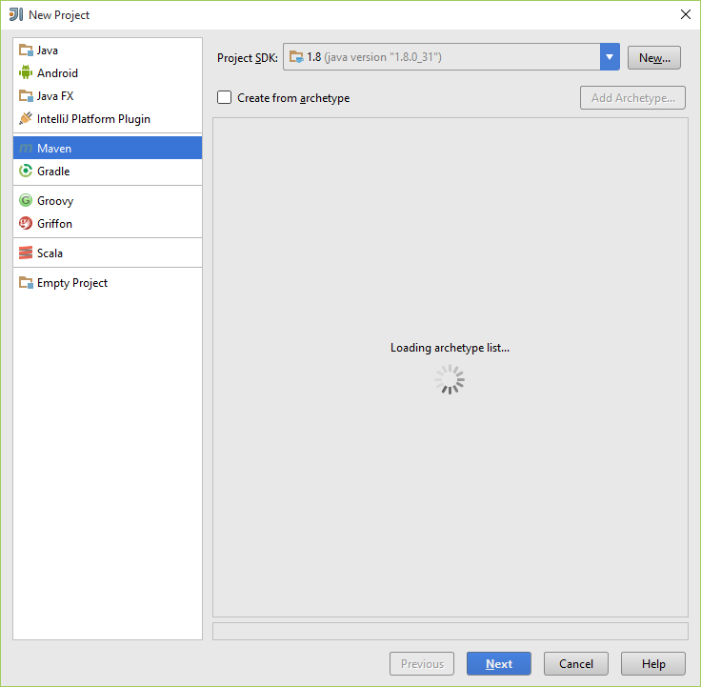
For Java Project

Slide 10
BUILD TOOLS: SBT and MAVEN

Slide 11
What is Build Tools?
Build automation is the act of scripting or automating a wide variety of tasks that software developers do in their day-to-day activities including things like:
compiling computer source code into binary code
packaging binary code
running automated tests
deploying to production systems
creating documentation and/or release notes

Slide 12
SBT
SBT stands for Scala Build Tool
SBT is an open source build tool for Scala and Java projects, similar to Java's Maven or Ant.

Slide 13
SBT - Installation
http://www.scala-sbt.org/0.13/tutorial/Installing-sbt-on-Windows.html
Install SBT.

Slide 14
SBT Commands
sbt clean : cleans the jars and classes generated from previous run
sbt package : creates a light jar, with the classes generated
sbt assembly : creates a fat jar without all the dependences compiled with it.
Note : we would be creating fat jar for deployment in spark

Slide 15
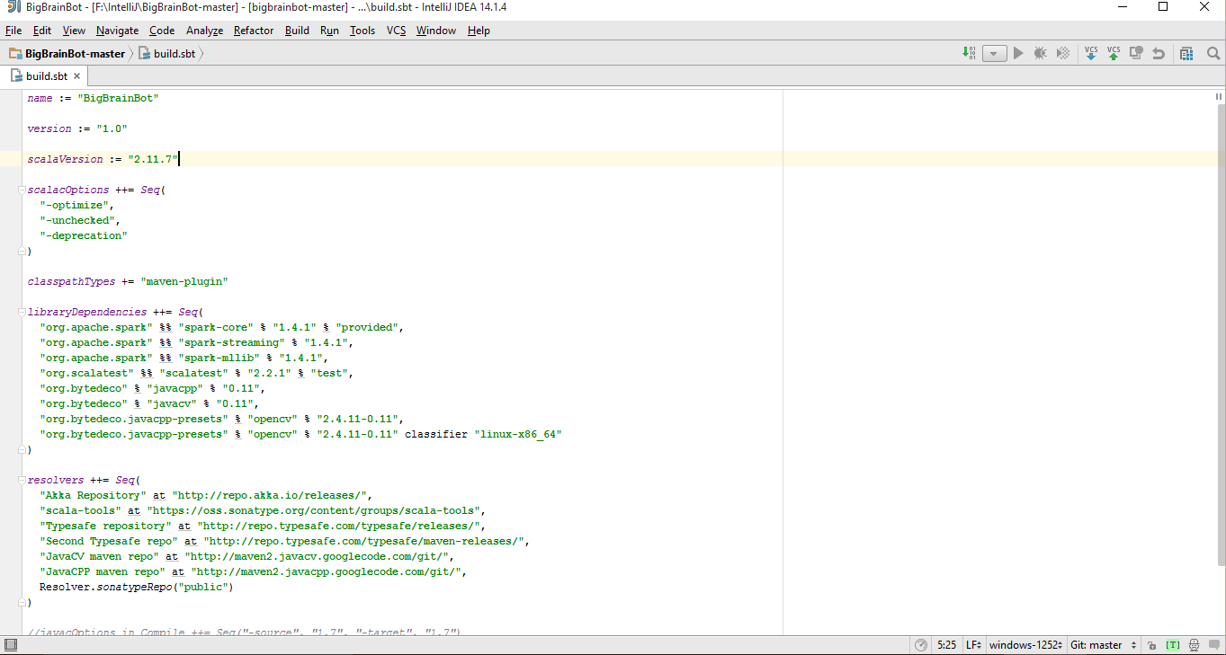
SBT related Files
Two main files which are involved with sbt are
Build.sbt : Dependencies libraries are specified

Slide 16
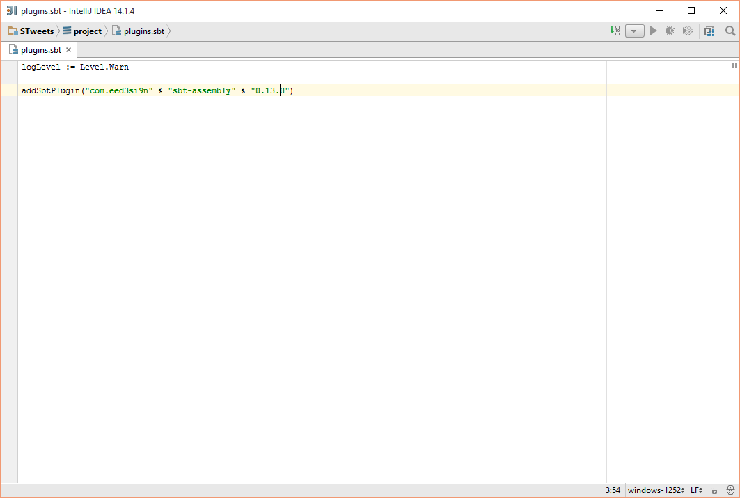
SBT related Files
Plugins.sbt / assembly.sbt : The version of sbt used is specified in this

Slide 17
Maven
Apache Maven is a software project management and comprehension tool. Based on the concept of a project object model (POM), Maven can manage a project's build, reporting and documentation from a central piece of information.

Slide 18
Maven Commands
mvn compile - compile the source code of the project
mvn test - test the compiled source code using a suitable unit testing framework. These tests should not require the code be packaged or deployed
mvn package - take the compiled code and package it in its distributable format, such as a JAR.

Slide 19
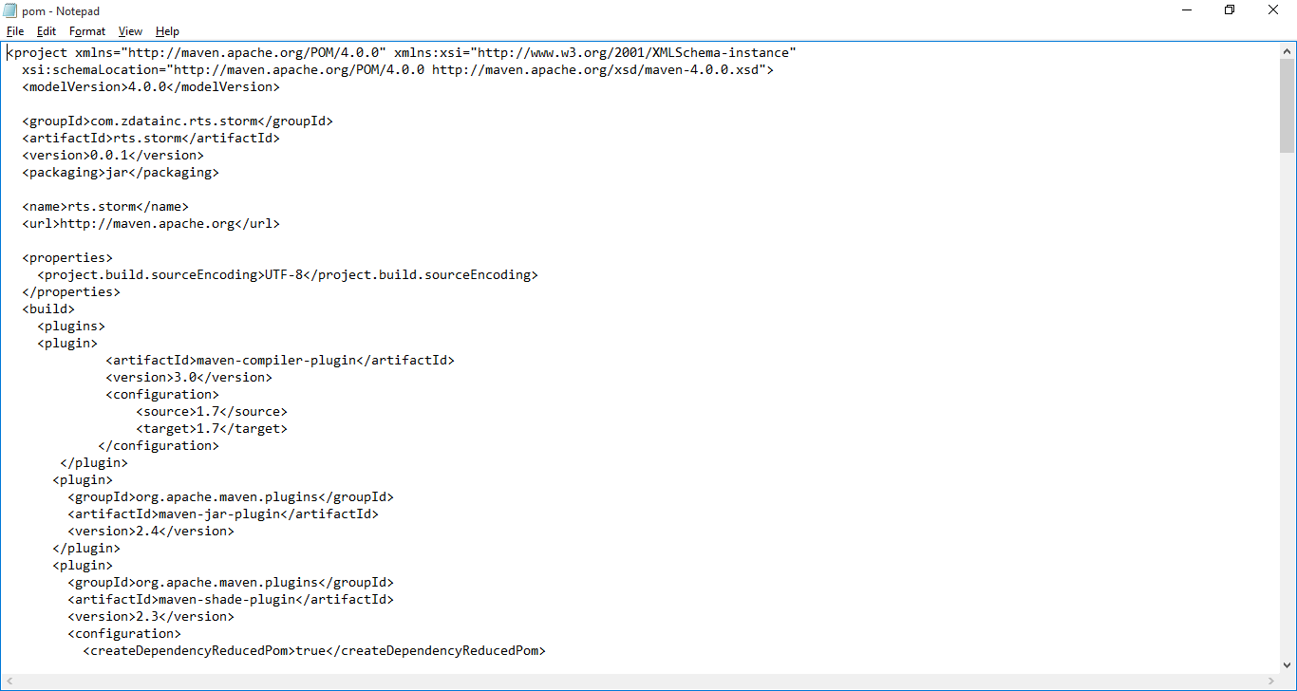
Maven related File: pom.xml

Slide 20
Install maven
Install maven in your local system
https://maven.apache.org/download.cgi

Slide 21
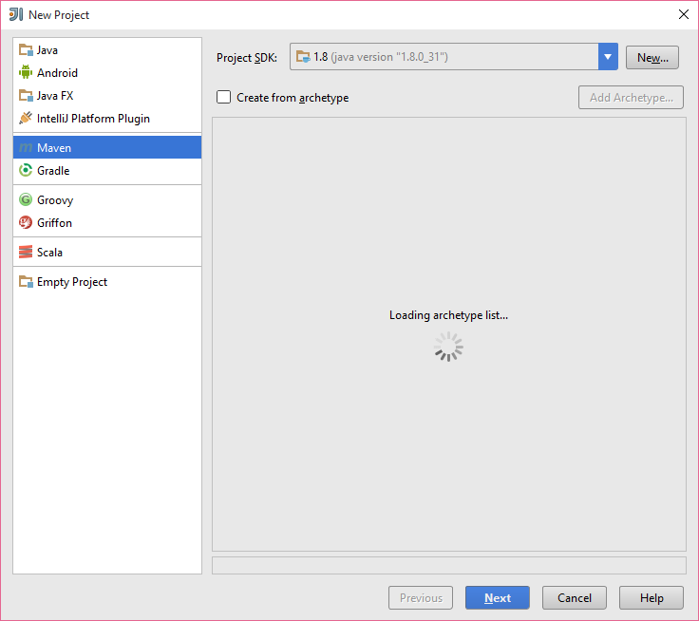
Maven MapReduce
Create a Maven Project in IntelliJ
Use the pom.xml from the existing project for Hadoop jars

Slide 22
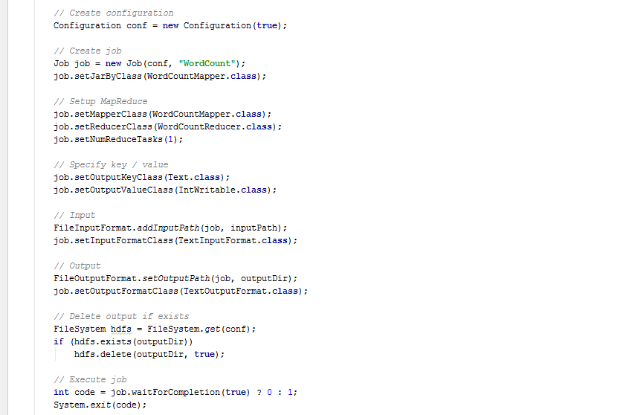
WordCount Main Class

Slide 23
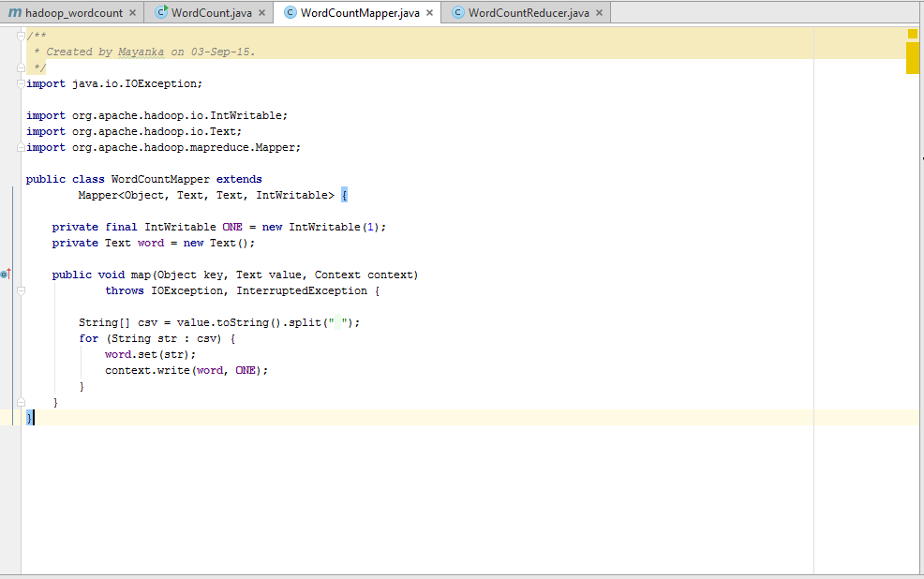
WordCount Mapper
I am a student
I like reading books
I: 1
am: 1
a: 1
student: 1
I: 1
like: 1
reading: 1
books: 1

Slide 24
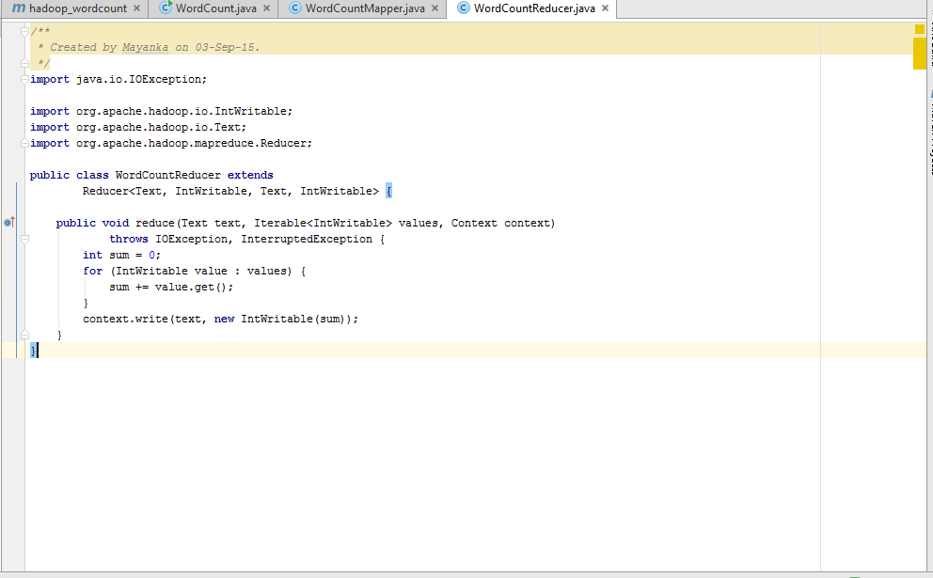
WordCount Reducer
I: 2
am: 1
a: 1
student: 1
like: 1
reading: 1
books: 1

Slide 25
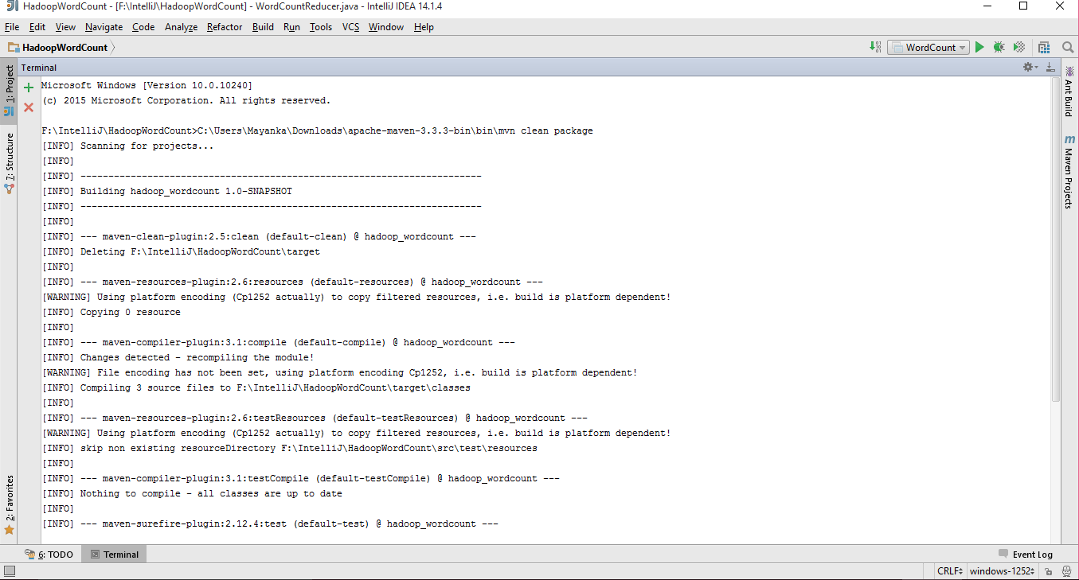
Debugging the project (command: mvn clean package)

Slide 26
Input File
Create two local files in terminal by the names input and output
Sudo vi input
Than add some data to it such as “How are you doing”
Push the file to Hadoop
[group1@kc-sce-cloudera-01 ~]$ hadoop fs –put localinput hadoopinput
hadoop fs –ls – this command displays hadoop files in the HDFS
[group1@kc-sce-cloudera-01 ~]$ hadoop fs -ls
Found 5 items
drwx------ - group1 supergroup 0 2015-09-04 16:22 .Trash
drwx------ - group1 supergroup 0 2015-09-04 16:23 .staging
-rw-r--r-- 3 group1 supergroup 15 2015-09-04 16:18 input
drwxr-xr-x - group1 supergroup 0 2015-09-04 16:23 output
drwxr-xr-x - group1 supergroup 0 2015-09-04 11:36 project

Slide 27
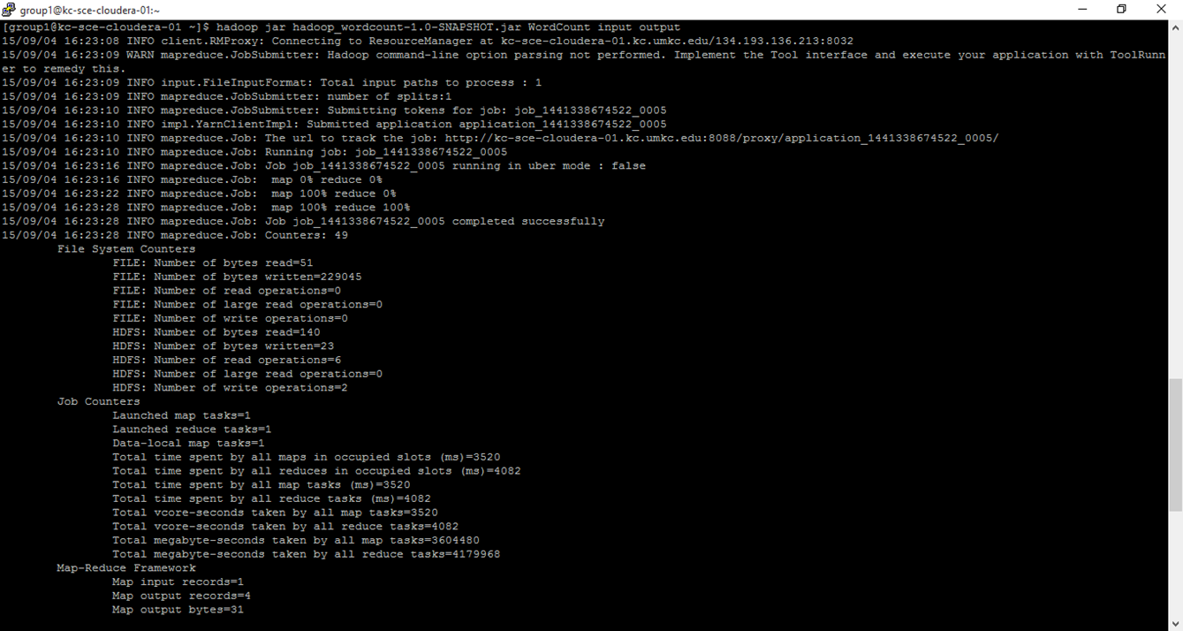
Run Hadoop WordCount
Command format - hadoop jar jarfile MainClass Input Output
[group1@kc-sce-cloudera-01 ~]$ hadoop jar hadoop_wordcount-1.0-SNAPSHOT.jar WordCount input output

Slide 28
Check output
hadoop fs –cat output/*
[group1@kc-sce-cloudera-01 ~]$ hadoop fs -cat output/*
Hi 1
are 1
how 1
you 1

Slide 29
Advanced Map Reduce Algorithms

Slide 30
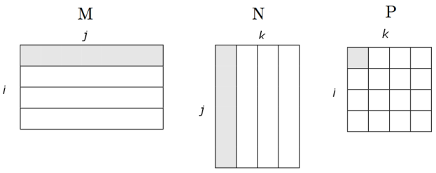
Matrix Multiplication

Slide 31
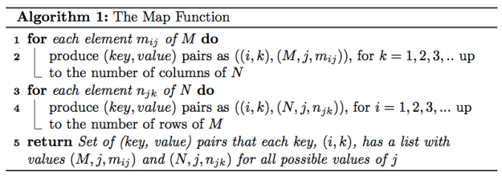
Map Function

Slide 32
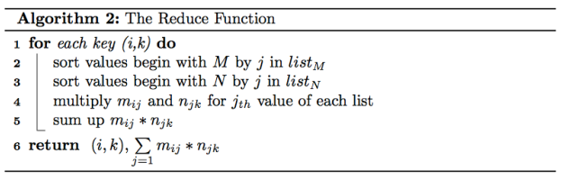
Reduce Function

Slide 33
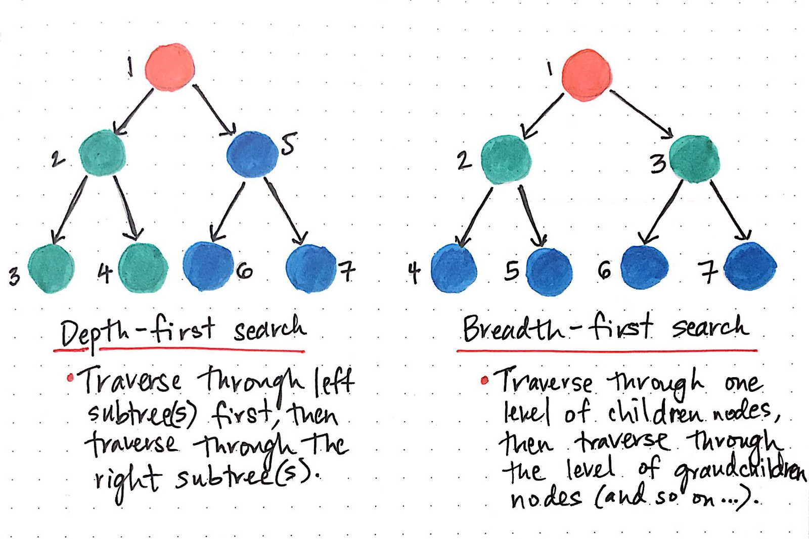
Breadth First Search / Depth First Search

Slide 34
References
http://hadoop.apache.org/docs/current/hadoop-project-dist/hadoop-common/CommandsManual.html
https://hadoopi.wordpress.com/2013/05/25/setup-maven-project-for-hadoop-in-5mn/

Slide 35
References
Map Reduce Patterns
https://highlyscalable.wordpress.com/2012/02/01/mapreduce-patterns/
Matrix Multiplication
http://www.mathcs.emory.edu/~cheung/Courses/554/Syllabus/9-parallel/matrix-mult.html
https://lendap.wordpress.com/2015/02/16/matrix-multiplication-with-mapreduce/
Breadth First Search
https://www.programiz.com/dsa/graph-bfs
https://www.hackerearth.com/practice/algorithms/graphs/breadth-first-search/tutorial/
https://www.programiz.com/dsa/graph-dfs

